Slide 1
A Data Pipline to Prove Fraud
Based on a true story...

Slide 2
Overview
Step 1. Exploratory Data Analysis (EDA)
  1a. Relevant Domain Knowledge:
    What context is motivating this analysis
  1b. What data might be relevant?
  1c. What does initial look at data suggest?
Step 2. What does the EDA suggest deserves a
closer look?

Slide 3
Overview
Step 3. What does the deeper analysis suggest?
Step 4. What would a third-party need to do in
order to reproduce this analysis?
  Why is reproducibility important in this context?
  Hint: What do you think would happen if these
  analyses were NOT reproducible?

Slide 4
Step 1a. Relevant Domain Knowledge
What context is motivating analysis?
Investment motivation:
  Before 2001, only Canadian banks were allowed to provide Point of Sale (POS) credit/debit card services
  Deregulation opened lucrative opp's for 3rd party providers
  CBS 2001 Inc. healthy revenue growth, but capital limited
After 2 months of DD, bought 29 terminals for $46k in Jan 2004.
  Term was 5 years. Annualized return was 20%

Slide 5
Step 1a. (Cont.) Context motivating analysis
CVP founded June 2004 to raise additional capital for CBS 2001
  1st client signed on Oct 2004
  CVP loans CBS 2001 $130k for add'l expansion
  5 more sign on between April 2005 and July 2006
July 2006 payment bounces. Aug – Dec: lots of unkept promises

Slide 6
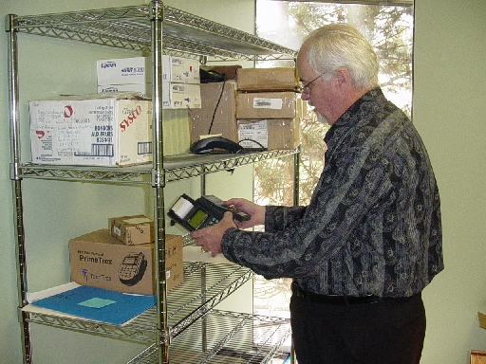
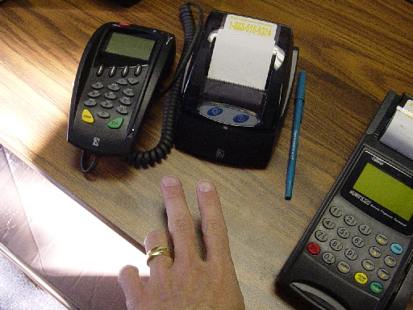
Step 1a. Domain Knowledge (cont.)
Demand letter Feb 2007. First action filed March 2007
Judgment June 2007
What exactly were those assets again?
CBS President holding a terminal
2 terminals and my left hand

Slide 7

Step 1a. Domain Knowledge (cont.)
It's June 2007 and you have a judgment. Now what?

Slide 8
Step 1a. Domain Knowledge (cont.)
It's June 2007 and you have a judgment. Now what?
Right! Try to collect on it.

Slide 9
Step 1a. Domain Knowledge (cont.)
It's June 2007 and you have a judgment. Now what?
Right! Try to collect on it.
But what do you think happened when you tried to collect on it?

Slide 10
Step 1a. Domain Knowledge (cont.)
It's June 2007 and you have a judgment. Now what?
Right! Try to collect on it.
But what do you think happened when you tried to collect on it?
Well, you manage to collect a percent or two using garnishments, but that money stops after a few months.

Slide 11

Step 1b. What data might be relevant?
You schedule your JDE for Decemeber 2007
  What's a JDE?
  This will be your 1st chance to request data.
  What do you ask for?

Slide 12
Step 1b. What data might be relevant?
You schedule your JDE for Decemeber 2007
  What's a JDE?
  This will be your 1st chance to request data.
  What do you ask for?
Right, you ask for information regarding the assets

Slide 13
Step 1b. What data might be relevant?
You schedule your JDE for Decemeber 2007
  What's a JDE?
  This will be your 1st chance to request data.
  What do you ask for?
Right, you ask for information regarding the assets
  Defendant claims company has no money or assets

Slide 14
Step 1b. What data might be relevant?
You schedule your JDE for Decemeber 2007
  What's a JDE?
  This will be your 1st chance to request data.
  What do you ask for?
Right, you ask for information regarding the assets
  Defendant claims company has no money or assets
  Now what?

Slide 15

Step 1b. What data might be relevant?
Right again! You ask who the company used as their payment processor.
Request data on merchants the company signed on over relevant time period
  1/2004 thru 4/2008 (most recent at that time)
What did this data look like?
  See jupyter notebook...

